Slide 1
Agent Studio
Onboarding Training Session 1
By the end of this session, you’ll know the basics of how PolyAI agents are built, and what tools will be available after go live.
Session Length: 45 Minutes
Notes:
Hey how are ya!?

Slide 2
Training Overview
Training Overview
Agendas
You’ll receive training over three sessions to get your team up to speed on how to analyse customer data
Intro to PolyAI Agents
Understand our build methodologies and the capabilities of Agent Studio, the PolyAI platform
1
Building and Managing Voice Agents | Hands On Session
Know how to use Agent Studio with interactive experience updating KBs, setting up AB tests and managing voices
2
Your Virtual Agent | Hands On Session
Explore your own virtual agent as we complete the build, and learn how to use our agentic analysis tools on your own data
3

Slide 3





Training Overview
Training Overview
Agenda
You’ll receive training over three sessions to get your team up to speed on how to analyse customer data
Intro to PolyAI Agents
Understand our build methodologies and the capabilities of Agent Studio, the PolyAI platform
1
What is Agent Studio?
The PolyAI Difference
Agent Studio Platform Tour
Recap and Next Session Preview
Questions

Slide 4
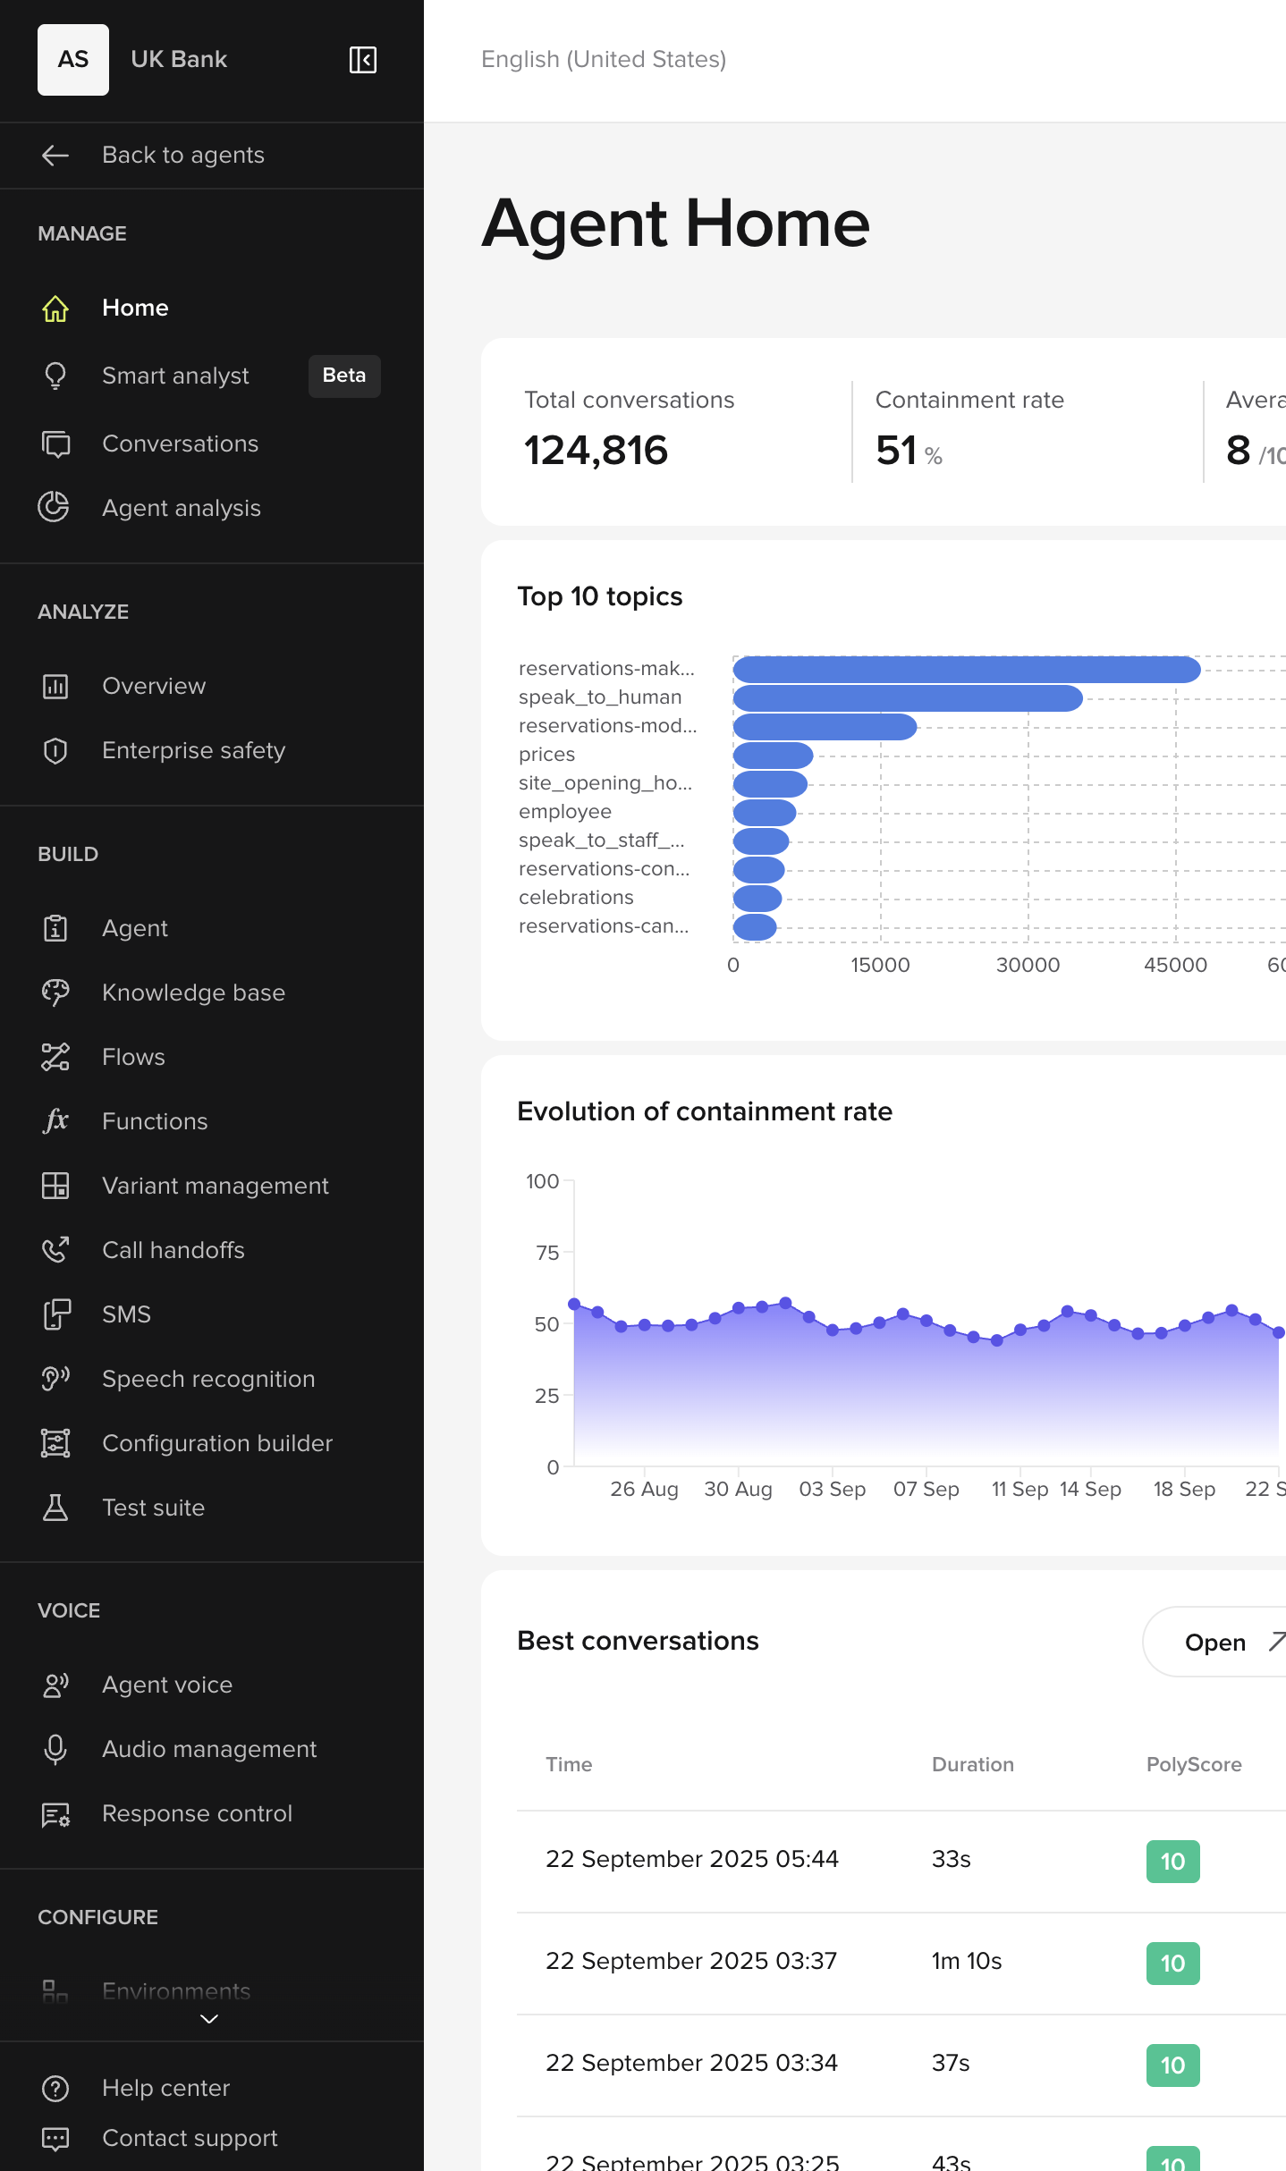
What is Agent Studio?
Two of the Same
What is Agent Studio?
Agent Studio is PolyAI’s virtual agent command center, where you’ll manage your agent’s performance.
Use agentic features such as smart analyst to dive deep into your data and call patterns. There’s no need to spend hours listening to calls, our AI surfaces the best and the worst for you to action.
Manage and Analyze
Update and Build
When you hear a call that could have been better, intuitive builder tools allow you to easily update facts, hours, personality, voices and more.

Slide 5
What is Agent Studio?
Two of the Same
What is Agent Studio?
Agent Studio is PolyAI’s virtual agent command center, where you’ll manage your agent’s performance.
Manage and Analyze
Update and Build
These are the same things!
Agent Studio is designed to help real data inform how you iterate on your agent. Analytics and Builder features are linked so you can quickly prioritise.
Agent Studio is also where PolyAI Agent Designers and Engineers complete most of their work.
It is designed to have the flexibility to do almost anything.

Slide 6

What is Agent Studio
Architecture
Agent Studio is the control layer for PolyAI’s proprietary technologies
Agent Studio
Conversation Reviews
Sentiment Analysis
Smart Analyst
Analytics Database
Your controls
Response Control
Channel Management
Latency Control
Voice Library
Knowledge Base & Flows
Speech to Text Engine
Text to Speech Engine
Retrieval Engine
Agent technologies
PolyAI LLM: Raven
GPT
Claude
Other LLM Options
Low latency cloud GPUs
Notes:
Another way to look at the platform is a control layer for all our technologies. You can optimize speech to text with transcript corrections in conversation reviews. You can manage how effective the retrieval engine is by how you structure your knowledge base, and under it all is our own LLM, that we have a lot of control over for safety and speed.

Slide 7
Agent Design
Intro
The PolyAI Difference | Agent Design
PolyAI has had a dedicated Agent Design who have mastered how to engage callers with virtual agents. Between them, they have a cumulative century in the field of human-computer interaction. Agent Studio makes these principles easy to follow.
Gain Trust, Quick
Most people don’t trust AI. It’s our role to change this, by creating an engaging and lifelike experience from the off. Start all calls with a lifelike and brief ‘How can I help?’ and let the user explain their intent as they would to a human.
Guide the user
Agent utterances should implicitly make clear how the user is expected to respond. ‘Can I take your name?’ might elicit the user to say ‘yes’ or ‘no’ and not give their name. ‘What’s your name?’ guides the user to say the right thing.
Listen Robustly
Customers say unexpected things, and you should be ready for it. The agent should be able to handle a large range of likely responses. This means making sure that when a user says something unexpected they aren’t stuck in a loop, and behavior is defined for misunderstandings.
Give Feedback
Trust in a virtual agent will grow every time the agent gets something right. You can speed this up by feeding back that the caller has been understood. Instead of responding vaguely, you could respond to a customer’s request to book a reservation with ‘Sure, I can make that booking’.

Slide 8


Agent Design
Intro
The PolyAI Difference | Agent Design
Support Correction
Always allow a caller to correct themselves and undo actions. Callers make mistakes, just like an agent will. It’s often beneficial to read back complex data.
Act Efficiently
Most people want to get their task completed as quickly as possible. Allow them by collecting multiple pieces of information in one go. If a caller volunteers all of their requirements upfront, make sure you can remember them and don’t ask again.
Speak Clearly and Naturally
Brevity is critical. Many large language models have a tendancy to give long, verbose responses. PolyAI’s Raven is trained to give short responses, however if you put too much information or heavy marketing material in your knowledge base, your agent won’t sound human.
…and more.
Our Agent Designers will help you with your first updates to your virtual agent.
In Practice
A major UK high-street bank saw a 26% increase in call handling when changing it’s greeting message to be shorter and less verbose.
A US utilities giant reduced the number of callers asking to speak to a human by 23% by removing “I’m a virtual assistant” from the greeting.

Slide 9
Agent Studio Tour
Training Overview
Agendas

Slide 10
What is Agent Studio
Architecture
Recap
Home
...to see what’s happening at a glance.
Smart Analyst
…to dive deeper.
Conversation Review
…to hear for yourself what smart analyst has told you.
Knowledge Base
…to add new content.
Custom Dashboards
…to monitor the impact.
Change Tracking
…to revert it or rollout to more users.
Notes:
Another way to look at the platform is a control layer for all our technologies. You can optimize speech to text with transcript corrections in conversation reviews. You can manage how effective the retrieval engine is by how you structure your knowledge base, and under it all is our own LLM, that we have a lot of control over for safety and speed.

Slide 11
Next Time
Training Overview
Agendas
You’ll receive training over three sessions to get your team up to speed on how to analyse customer data
Intro to PolyAI Agents
Understand our build methodologies and the capabilities of Agent Studio, the PolyAI platform
1
Building and Managing Voice Agents | Hands On Session
Know how to use Agent Studio with interactive experience updating KBs, setting up AB tests and managing voices
2
Your Virtual Agent | Hands On Session
Explore your own virtual agent as we complete the build, and learn how to use our agentic analysis tools on your own data
3

